Slide 1
Introduction to Social Purpose
2026

Slide 2

Copyright Information
We encourage you to use, share, and adapt this resource to advance the purpose economy. Please attribute the Canadian Purpose Economy Project. This work is licensed under the Creative Commons Attribution-NonCommercial 4.0 International (CC BY-NC 4.0) License.

Slide 3
Definition of Social Purpose Business
A social purpose business is a business whose reason for being is to create a better world.
Its purpose is to profitably solve the problems of people and planet without causing harm to either.
It is the company’s optimal, strategic contribution to the long-term well-being of all people and the planet.
Social Purpose businesses unlock all their enterprise capabilities, talents, resources,
partnerships, and influence in pursuit of their purpose.
The social purpose acts as the company’s North Star, helping it steer and navigate through
turbulent times and mobilizing employees and stakeholders around it.

Slide 4
Our Vision
By 2030, 25% of Canadian businesses are adopting, disclosing, and authentically embedding a social purpose across their operations and relationships, and collaborating with others to achieve it.
This will be the tipping point.
Notes:
Leader: there are other related initiatives around the globe that we will connect into as well (list some) – and we want to bring our thought leadership, actions and outcomes to the rest of the world to influence Purpose everywhere.
We have chosen that number because we believe 25% will create a tipping point beyond which it will be normal for Canadian businesses to have a societal purpose as their reason for being—and will be unlocking all their assets for social good, putting Canadian society on a sustainable path.

Slide 5
The problems we are solving
Our economic system rewards short-term financial profits over long-term societal well-being and reinforces the view that businesses exist to create profits
A pervasive belief that businesses act primarily in their own financial interests, eroding trust in business
Under-utilization of business capabilities to contribute to societal well-being
Business leaders lack practical guidance on defining and running social purpose businesses

Slide 6
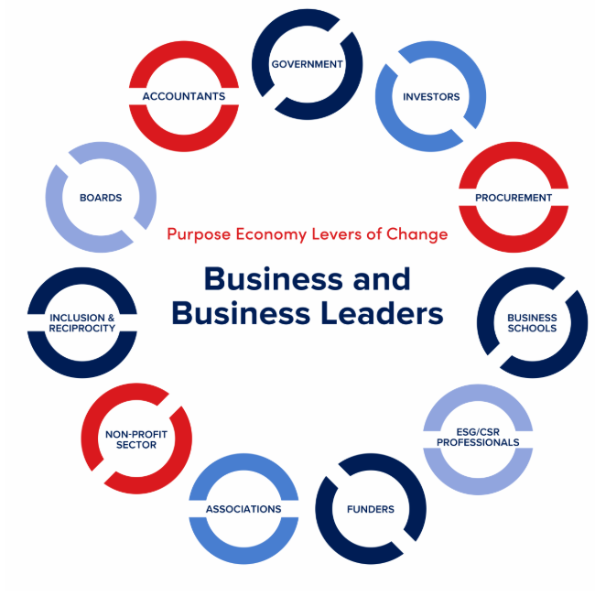
How? Leverage Points
The following are key levers for accelerating the growth of a purpose economy.
For each of these levers we are establishing initiatives to create an enabling environment for social purpose business to start, transition, grow and thrive.​

Slide 7
Towards a Purpose Economy
“A Purpose Economy is an economy powered by the pursuit of long-term well-being for all in which business and regulatory and financial systems foster an equitable, flourishing, resilient future.”

Slide 8
Influence on Frameworks and Standards
These ideas are increasingly reflected in national and global frameworks and standards:
National
The Directors College Chartered Director Program
Governance Professionals of Canada Chartered Governance Professional
    International
B Corp
ISO 37011 (draft guidance on purpose-driven organizations)
CECP’s Integrated Long-Term Plan Framework
FCLT Global resources

Slide 9













Social Purpose Business Ecosystem
Financial Services
Manufacturing
Software and Technology
Professional Services
Construction
Food and Beverage

Slide 10

BlackRock on the Purpose Value Proposition
“In our experience, a well-defined purpose supports a clear sense of direction in corporate leadership, and helps companies to compete, navigate short-term challenges, and achieve long-term growth. This in turn helps companies to attract and retain a high caliber workforce, build stronger customer loyalty, and maintain investor confidence. These factors are important to building financial and business resilience, attracting long-term capital and delivering durable profitability.”
- January 2026 Investment Stewardship Engagement Priorities: Strategy, Purpose and Financial Resilience

Slide 11
Mission, vision, purpose definitions
What your company does
MISSION
Where your company is going
VISION
Why your company exists
PURPOSE

Slide 12

Purpose Aligns Vision, Culture, Strategy
Business Architecture
Purpose
WHY?
Vision
WHERE?
Mission
WHAT/HOW?
Culture
Strategy
Branding
Values
Metrics

Slide 13

How does an organization uncover its ‘Best Fit’ Social Purpose?
The intersection between society’s needs and who you are creates big, bold opportunities
What the World Needs
Purpose
Who You Are

Slide 14


The Needs of the World: UN 2030 SDGs

Slide 15
Maple Leaf Foods Example
This is how the company eventually came to identify its social purpose, by triangulating the needs of the world, with its business opportunities and core assets:
What the World Needs
Food security
Climate change
Animal health
Nutrition
Sustainable food system
Business Assets
Canada’s largest value-added meat protein company
Leading Canadian brands
Farm to fork
Owns world-class processing plants
Creating high growth market
Social Purpose
Raise the Good in Food

Slide 16

Four Types of Purpose
PRODUCT PURPOSE
SOCIAL
PURPOSE
PROFIT PURPOSE
CUSTOMER
PURPOSE

Slide 17


Social Purpose vs. CSR or ESG
SOCIAL PURPOSE
CSR/ESG
A company’s societal reason to exist
A company’s approach to managing its social and environmental risks and improving its social or environmental performance

Slide 18


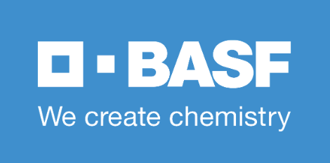
Sample Social Purpose Statements (Global)
To inspire makers and innovators
to create a more sustainable world.
To bring health through food to as many people as possible.
To create chemistry for a sustainable future.

Slide 19



Sample Social Purpose Statements (CDN)
To keep the planet cold and the people on it warm.
To boldly grow the good in business and in life.
To reimagine commerce in ways that build a more fulfilling and lasting world.

Slide 20
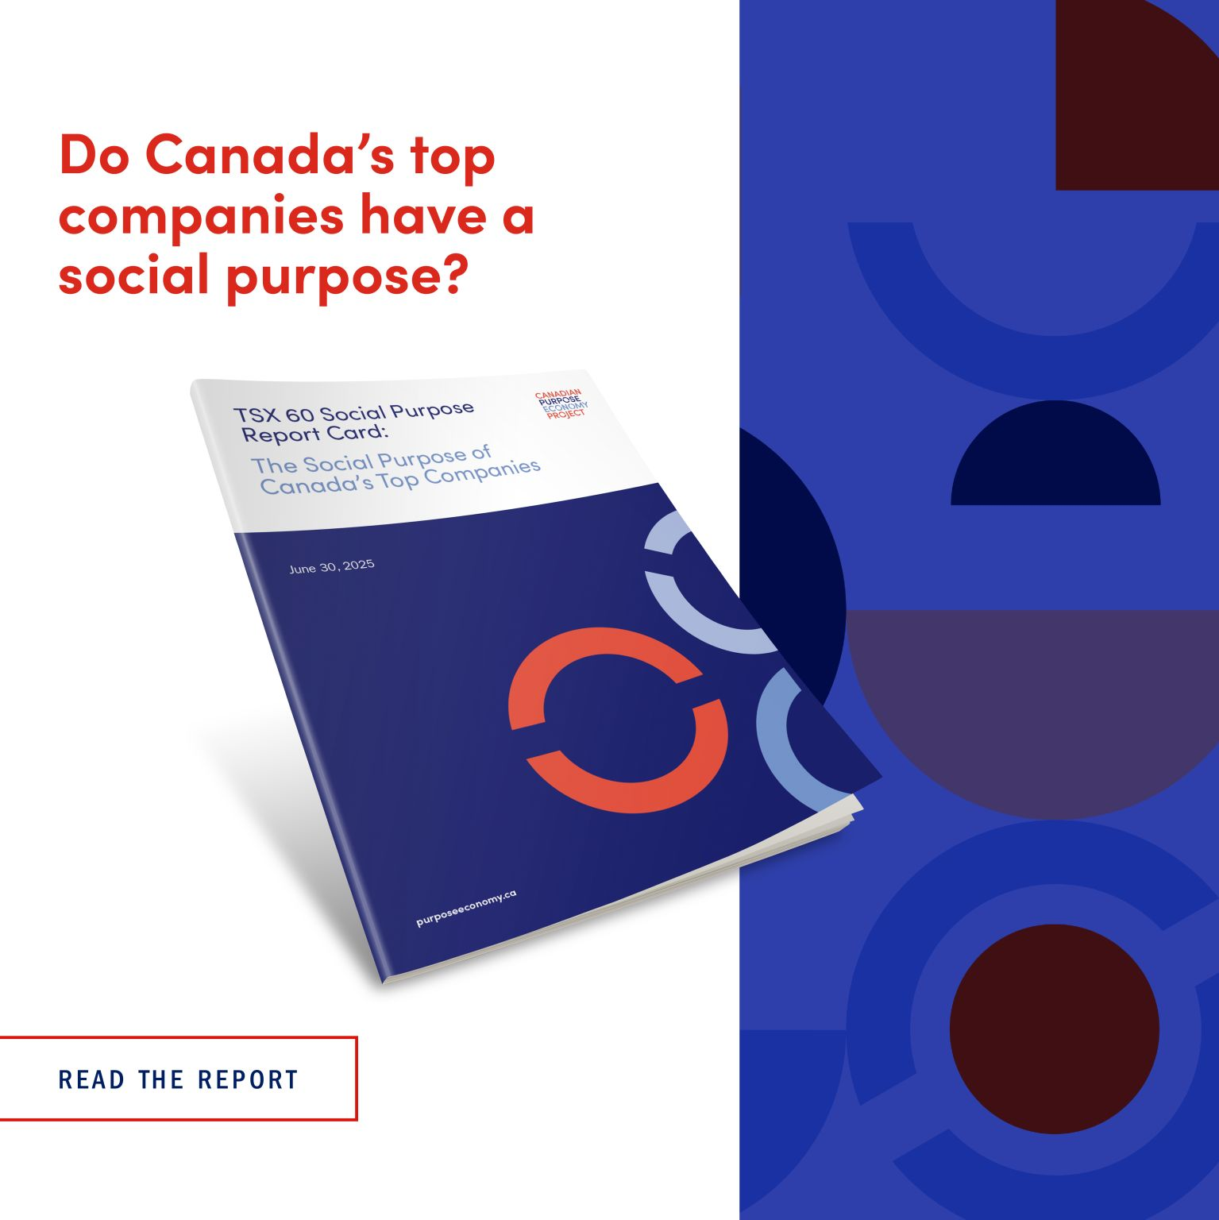
40% of the TSX60 list of Canada’s largest, publicly traded companies have a purpose to create a better world.

Slide 21
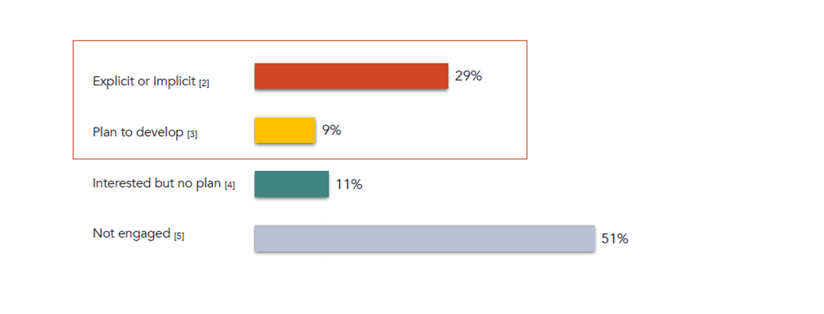
38% of Canadian SMEs have or plan to develop a social purpose
Source: Angus Reid Forum survey commissioned by Filene Research, 600 Canadian SMEs with revenues between $250,000 and $5M.

Slide 22
Business Case for Social Purpose
Strengthen Relationships and Enable Collaboration
Recruit, Retain and Engage Employees
Attract, Retain and Engage Customers
Strengthen Operating Context and Increase Trust
Enhance Financial Performance and Access to Capital
Increase Innovation and Enhance Resiliency

Slide 23
Key Implementation Steps
Board: Update Terms of Reference to include Purpose Oversight
Employees: Educate and engage employees and build into employee experience
Decisions: Adopt a social purpose decision lens
Strategy: Include social purpose goals and targets
Incentives: Include in compensation and performance objectives
Products: Embed social purpose
Stakeholders: Consult and mobilize stakeholders on the social purpose
Reporting: Disclose social purpose progress

Slide 24
Canadian Purpose Economy Project Home
CPEP is a project of the Canadian Business for Social Responsibility (CBSR) Education Foundation
The Foundation is a registered Canadian charity that provides financial administration and institutional support

Slide 25
Join us!
purposeeconomy.ca

Slide 26
Social Purpose Action
Canadian Purpose Economy Project; purposeeconomy.ca
Sign up for the newsletter, follow us on LinkedIn
Access our resources
Social Purpose Company: CEO to sign the Call to Purpose
Other companies: raise awareness of social purpose internally
Open to sponsorship, funding and partnerships
Refer us to associations in your network

